Slide 1
NETWORKED APPETITE
Anamika Kafle
Aakriti Neupane
Bishwas Ghimire
Gaurab Rana
Mansi Deep

Slide 2
Outline of this presentation
Project Charter
Team Contract
Belbin Analysis, Roles and Responsibilities
Ms Project For Project Management
EERD, ERD, Composite ERD, Logical Table
Functional and Non-Functional Requirements
Use Case Diagram (Admin, Customer, Trader, Overview)
Wireframing

Slide 3

Project Charter
Project Charter outlines the justification, scope, duration and estimated budget and, roles and responsibilities of the project. The purpose of a Project Charter is:
To provide an understanding of the project, the reason it is being conducted and its justification.
To provides a introductory definition of roles and responsibilities.
To establish early on in the project the general scope.
To define the authority of the project manager.
To provide a shared understanding of the project.

Slide 4
Project Justification
To build an ecommerce platform in order to sell their fresh products and justify to customer basic needs and requirements.
To keep the business stable with high-income in online platform.
Traders arrange their respective items in an appropriate form and gain profit as they reach to customers' doorstep in their manageable time.
Traders add their items with a short description about the cost of the item, amount per item, stock accessible, minimum as well as maximum order information and furthermore ought to incorporate about their positive and negative side of their items.

Slide 5
Project Scope
The objective of the project should contain a measure of how to assess whether they have been achieved. It should be realistic, and include the objectives. The objectives should be SMART:
S – Specific
M – Measurable
A – Achievable
R – Relevant
T – Time Bound

Slide 6
Customer Interface
Navigation to products by shop or by product type.
Login and registration system.
Choose available collection slot after 24 hours of order confirmation and payment through PayPal.
Traders Interface
Products CRUD operations.
Generate daily and monthly reports.
Specific trader account and unique product items.
Admin role to access whole system.
Admin Interface
Admin dashboard to view overall statistics.
Daily reports of goods and quantities.
Weekly finance reports and monthly reports on product sales.

Slide 7
Duration and time bound
Initial: Feb 3rd 2020
Work in Progress: March 18th 2020
Final: May 15th 2020
Each member will contribute 2-2.5 hours per day towards work, so total Estimated Hour up to week 12 = 690 hours.

Slide 8

TEAM CONTRACT

Slide 9

Why have a contract?
A team contract is used so that all members of the team understand their role on the team. Each team will generate their own contract and mechanism for self-assessment.
Objectives
Discuss issues with doing a team project.
Clearly state expectations for yourself and team members.
Make sure you know what the expectations are for project.
Create a leadership structure for team.
Decide on responsibilities for each team members.

Slide 10
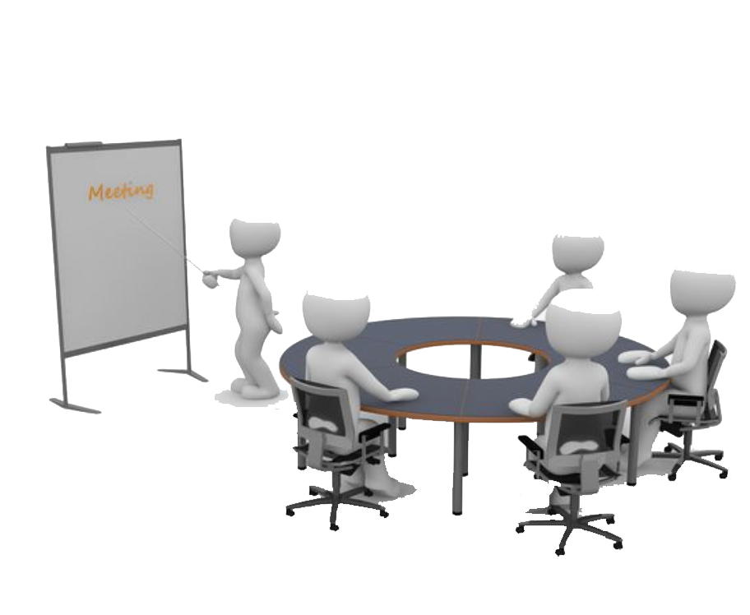
Meeting Information
During group projects, we will meet the Tuesday and Friday prior after regular classes at any available classrooms.
Depending on the time commitment, we will meet later in the week accordingly.
Special meeting may be set up during special circumstances throughout the project.(i.e. extra help/practice)

Slide 11
Team Procedure and Accountability
Each member has one excused absent from a meeting, before he or she is compelled to have extra load from the leader.
For every meeting and classes, attendance is compulsory.
Sign and agreement is required for the contract.
File Sharing and Communication
Along with file sharing , open conversation is also done in Slack and Gmail
under our group name Team 5.

Slide 12
Action Plan
Each group project will be done to ensure equity among each group member.
Leader : Changes once every week.
Team Recorder : Gaurab Rana
Meeting Agenda : Anamika Kafle
Record Keeping : Team Leader

Slide 13
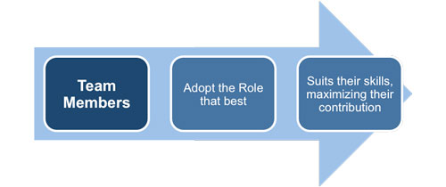
Belbin Analysis
Belbin suggests that, by understanding your role within a particular team, you can develop your strengths and manage your weaknesses as a team member, and so improve how you contribute to the team.
Team leaders and team development practitioners often use the Belbin model to help create more balanced teams.

Slide 14
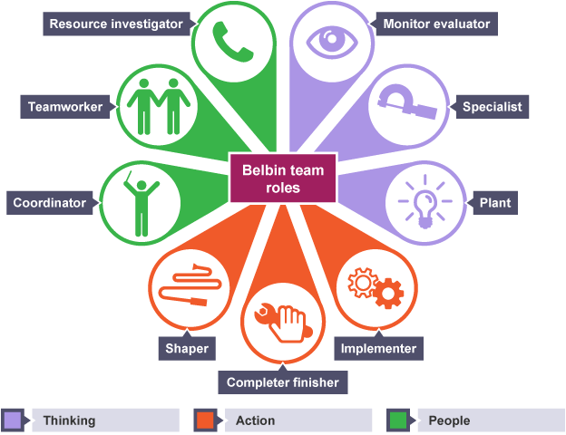
Team Roles
Plant
Specialist
Monitor evaluator
Resource investigator
Team worker
Coordinator
Implementer
Shaper
Completer finisher

Slide 15

Our Role as a team members
NAME | Primary role | Secondary role | Least likely role
Anamika | Co-ordinator | Monitor Evaluator | Implementer
Aakriti | Monitor Evaluator | Implementer | Plant
Mansi | Resource Investigator | Team Worker | Implementer
Bishwas | Team Worker | Resource Investigator | Co-ordinator
Gaurab | Specialist | Shaper | Completer Finisher

Slide 16

Plant
Team role contribution
Creative
Free Thinkers
Imaginative
Generates ideas
Possible weakness
Disorganized
Inclined to ignore practical details.

Slide 17

Specialist
Team role contribution
Greatest depth of knowledge.
Single-minded
Dedicated
Passionate about their knowledge.
Possible weakness
Only make a contribution to a narrow set of issues.

Slide 18

Monitor Evaluator
Team role contribution
Good at judging the team.
Critical Thinking
Developing ideas to fulfillment.
Moving slowly and precisely.
Comes to the right decision.
Possible weakness
Can’t inspire others well.
Can be overly critical.
Cynicism

Slide 19

Resource Investigator
Team role contribution
Enthusiastic
Explores opportunities.
Makes and develops new contact.
Fixer
Maintaining harmony within team.
Possible weakness
Rapid loss of interest.
Over optimistic.
Poor follow-through
Forget the detail.

Slide 20

Team worker
Team role contribution
Counsellor and conciliator.
Improves intra-group communication.
Building on suggestions.
Corporative, perspective and diplomatic.
Listens and averts friction.
Possible weakness
Tends to avoid confrontation.
Indecisive
Avoiding pressure situations.
They won’t take sides.

Slide 21

Coordinator
Team role contribution
Clarifies goals.
Identifies talent.
Good listener.
Confident and mature.
Good at delegation.
Possible weakness
Can be manipulative.
Delegates all work, leaving themselves little work to do.

Slide 22

Implementer
Team role contribution
Turns ideas into concrete action.
Efficient, well disciplined.
Deals with practical details.
Organizing.
Loyal to their team-mates.
Possible weakness
Can be inflexible.
Obstructing change.
Unresponsive to new ideas.

Slide 23

Shaper
Team role contribution
Focused leadership.
Motivated to success.
High desire to win.
Committed to shaping the teams work.
Possible weakness
Argumentative
Not always likeable.
Prone to irritation.

Slide 24

Completer Finisher
Team role contribution
Perfectionist.
Conscientious.
Sense for accuracy.
Goes the extra distance.
Following through.
Possible weakness
Worrying to much.
Perfectionism.
Obsessive behavior.
Negative thinking.

Slide 25
Ms Project Professional 2010
Microsoft Project is a project management software product, developed and sold by Microsoft. It is designed to assist a project manager in developing a schedule, assigning resources to tasks, tracking progress, managing the budget, and analyzing workloads.

Slide 26
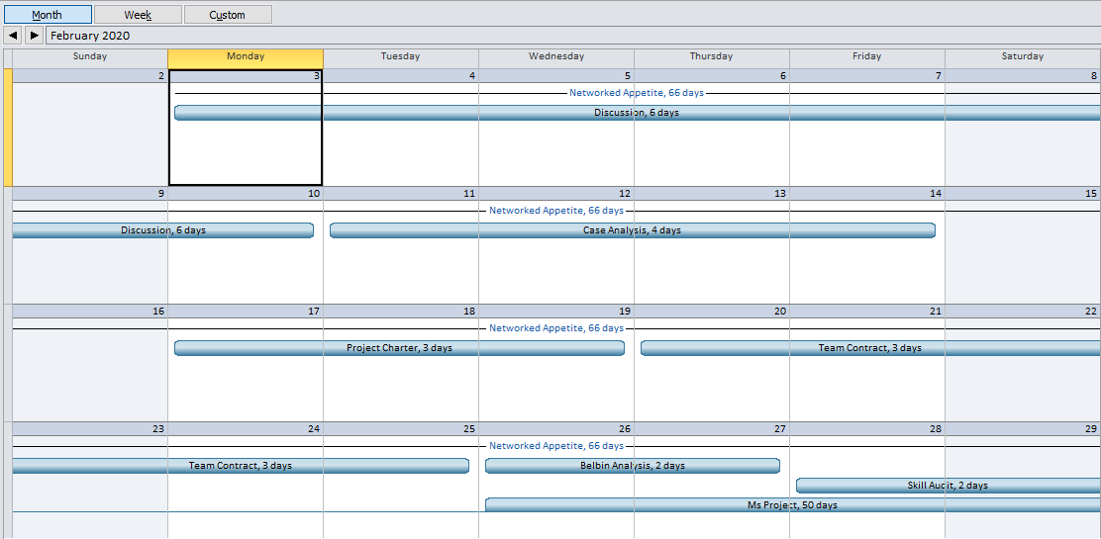
Calendar
February 2020
Discussion
Case Analysis
Project Charter
Team Contract
Belbin Analysis
Skill Audit

Slide 27
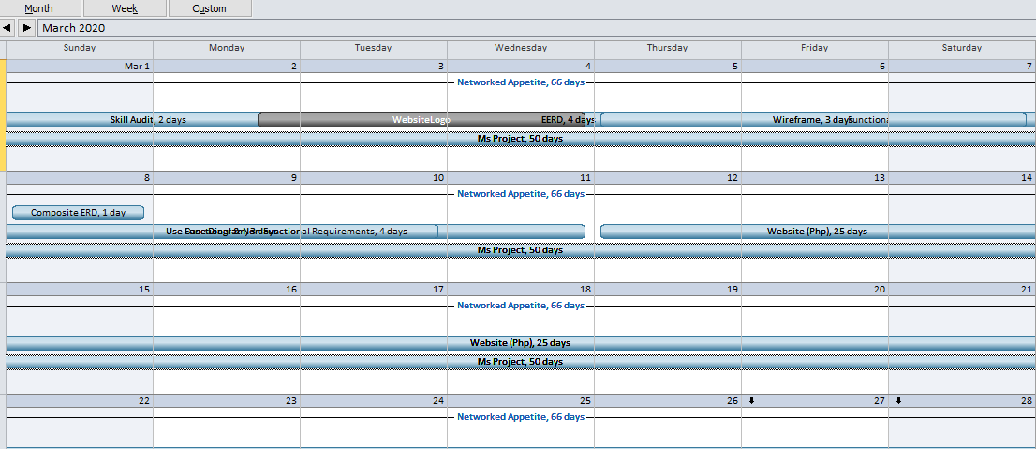
March 2020
EERD
ERD
Composite ERD
Functional & Non-Functional Requirements
Use Case Diagram
Website Logo
Wireframe
Website

Slide 28
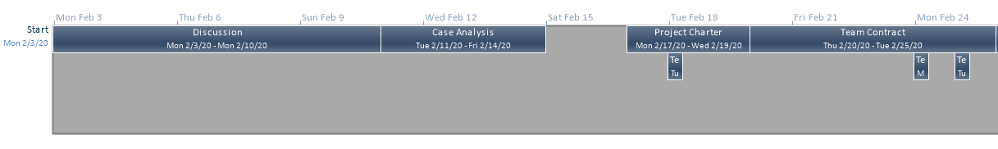
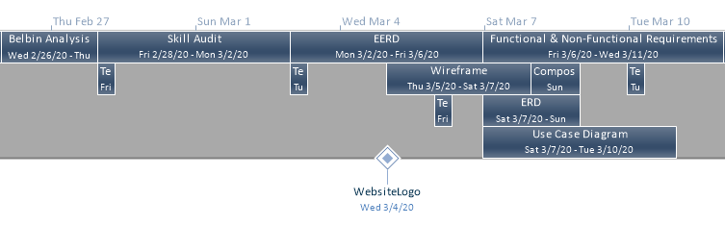
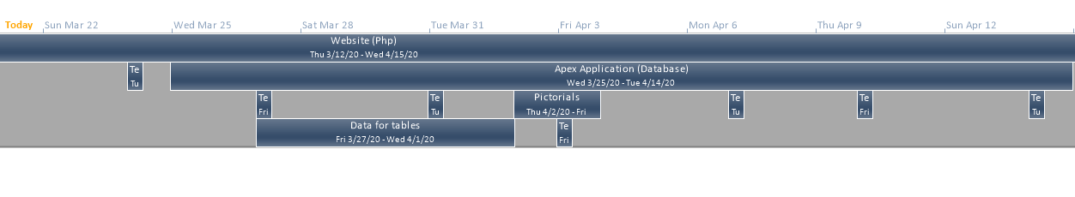
Timeline

Slide 29
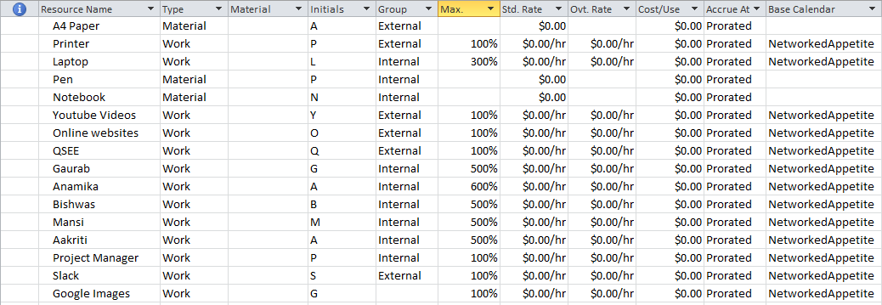
Resource Sheet
Every Resources used during this project are listed here.
They can be of type Material, Work or Cost. Resources in external group are those which we don’t own and internal group are those which we own.

Slide 30
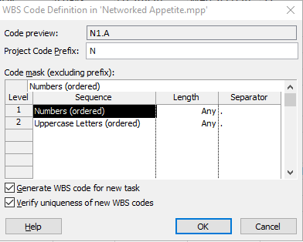
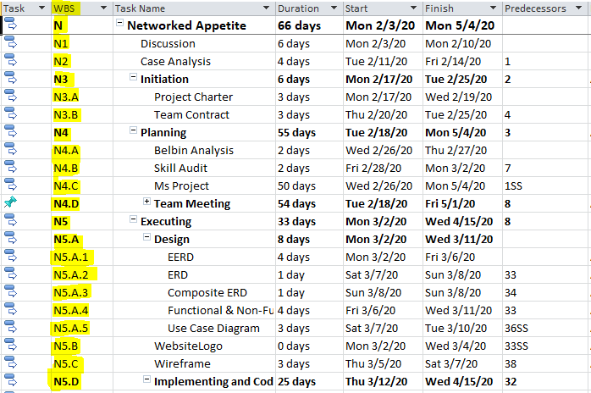
Work Breakdown Structure
WBS Code can be defined manually as per choice in Ms Project.
WBS Code sequence in this Gantt chart is Prefix N followed by Numbers(ordered) and followed by Alphabets in Uppercase where dot(.) is separator between two sequence.
Each WBS code is unique to each other.
For example:- Main task Networked Appetite has code N. Subtask Initiation has N3 and its subtask has code N3.A

Slide 31
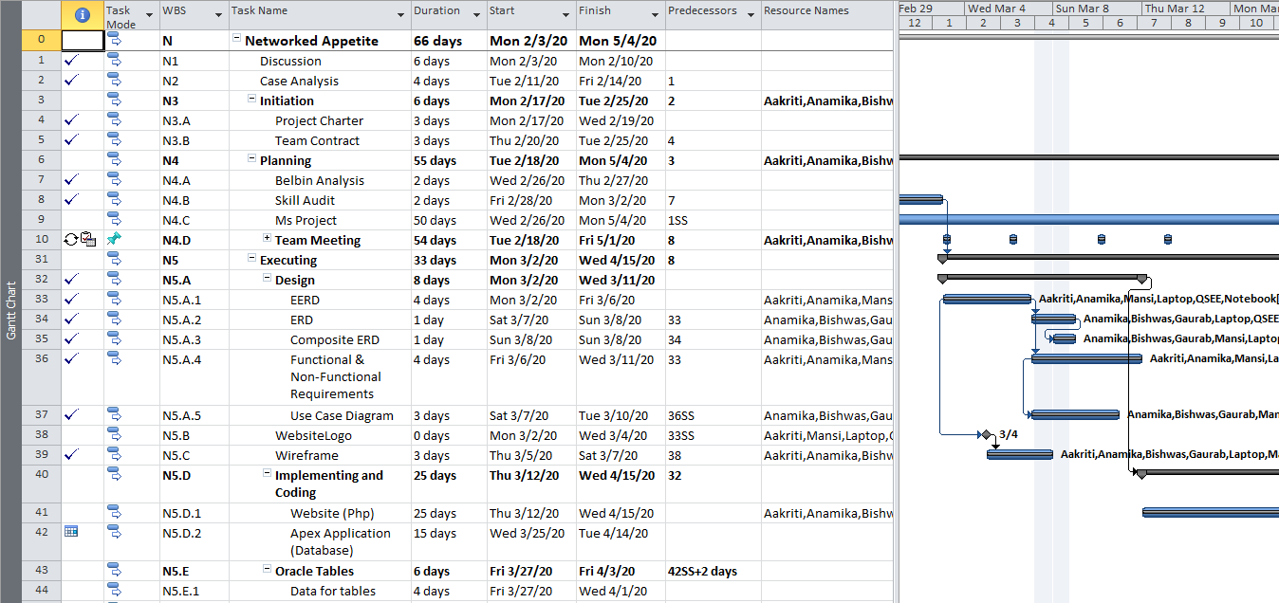
Gantt Chart
All the tasks to be performed are listed along with their start and finish date and resources used.
Each task has a WBS code to maintain uniqueness.
Tasks can be scheduled manually or auto.
The right part of chart shows calendar where task are shown with resources used along with duration date.

Slide 32
EERD(Extended Entity Relationship Diagram)
It is an Extended version of entity relationship diagram with one to many , many to one and many to many relationship with no linked entity present.

Slide 33
EERD

Slide 34
EERD
This diagram consists of different entities like users ,review ,discount ,shop ,product ,cart ,order , payment and collection slot.
Users entity has be sub classified into Admin , Trader and Customer.
Admin manages both the trader and customer as it has full authority over them.
Sub type trader has one to one relationship with shop as one trader can open one shop and shop has further one to many relationship with products as in one shop can put on many products.

Slide 35
EERD
Also trader can offer discount to customer which lead to one to one with optionality. Also discount is given to products which have one to one with optionality relationship. Also, product has many to many relationship with order which leads to many to one relationship with collection slot for both the trader and customer.
Order entity has further relationship with payment and cart. With Payment entity order has one to one relationship which has one to one relationship with Customer sub type.
Cart as an entity has relationship with product and customer. With Customer cart has one to one relation. Also cart has many to many relationship with product which is additionally linked with other entities as well.

Slide 36
EERD
Customer sub type has additional relationship with review which includes one to many relation with optionality which has relationship with other entities like product which is also linked with maximum entities.
Admin sub type has one to many relationship with both traders and customers.

Slide 37
ERD(Entity Relationship Diagram)
ERD is same as extended ERD with many to many relationship with link entity.
All the mentioned entity in the EERD are same in ERD.
User entity is not classified into subtype like in ERD which is the difference between EERD and ERD along with the same relationship.

Slide 38
Composite ERD

Slide 39
Composite ERD
In this diagram, additionally attributes to particular entity are added .
Also, a link entity is added to those entities where many to many relationship exist.
Composite ERD is a type of ERD where entities and its attributes are properly arranged in a well managed form.

Slide 40
Logical Table
Entity Names | Attributes
User | UserID, Type, Name, Address, Gender, Email, Password
Shop | ShopID, TraderType, UserID
Cart | CartID, UserID
Discount | DiscountID, Amount, UserID
Review | ReviewID, Description, ProductID, UserID, Rate
Product | ProductID, Name, Description, Price, DiscountID, ShopID, QtyInStock, UserID
Product_Cart | ProductID, CartID, Quantity
Order | OrderID, Description, OrderDate, CartID, SlotID
OrderDetails | ProductID,OrderID, Quantity, TotalPrice
CollectionSlot | SlotID, Day, CollectionTime
Payment | PaymentID, Status, UserID, OrderID

Slide 41
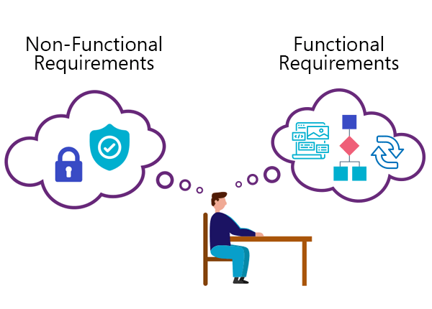
Functional and Non-functional requirements

Slide 42
Functional requirement
Functional requirements are product features or functions that developers must implement to enable users to accomplish their tasks.
Generally, functional requirements describe system behavior under specific conditions.

Slide 43
A system should have the capability to maintain account records.
Ability to make transactions corrections and cancellation of the work it has done.
External interface should be present so that an outside user is able to use the system.
Legal and regulatory requirements need to be followed.
The system should be able to fulfil with the legal requirement and follow the regulations of its major body.
It should be in a simple language and non ambiguous in nature to make itself user friendly and easy to navigate.
It should have the facility to provide authorization to its users.
This way different level of users can perform work on same system as per their user authority.

Slide 44
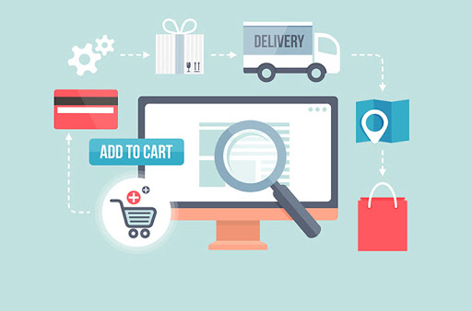

Slide 45
Non-functional requirement
Nonfunctional requirements describe how a system must behave and establish constraints of its functionality. This type of requirements is also known as the system’s quality attributes.
They are contrasted with functional requirements that defines specific behavior or functions.

Slide 46
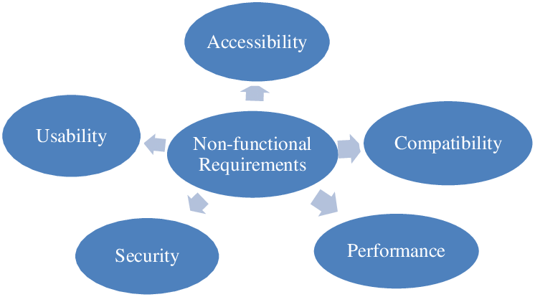

Slide 47
Performance - this includes the response time of the system’ utilization level of both static and volumetric type output.
Security - security measures should be embedded in the system to ensure that the records present in the system are secure and no unauthorized personnel can access them.
Maintainability - the system should be designed in such a way that they can be serviced and maintained on a periodic basis.
Compatibility – User experience should be given top most priority while planning to offer an ideal web experience to your users.
Usability – includes a small learning curve, easy content exploration, findability, task efficiency, user satisfaction, and automation.
Accessibility - websites, tools, and technologies are designed and developed so that people can perceive, understand, navigate, and interact.

Slide 48
UML USE CASE DIAGRAM
Purpose
Diagram

Slide 49
The purpose of use cases
Uncover and describe all tasks that need doing in a system (of both human and system actors)
To analyze the functionality that needs development for the system.
The use of use cases must mean that the right functional requirements are made of the IT system.

Slide 50
Customer Use Case Diagram
Top level use cases are login, Buy product,
View cart details.
Product search and sort use case could be used by customer as top level use case if customer only wants to find and see some products.
Payment use case is included use case not available by itself – payment is part of buying products.
Customers can review, manage profile, view cart only after logged in.
Order confirmation by email is extended use case in case of payment error.

Slide 51
Trader Use Case Diagram
Login use case is included use case as
needed for adding shop, managing
account and product.
Manage stock is included use case not
available by itself- it’s a part of managing
product.
Trader can give discount to their customers
as well as can update, add, delete their
products.
Anytime traders can view their daily, weekly
and monthly report.

Slide 52
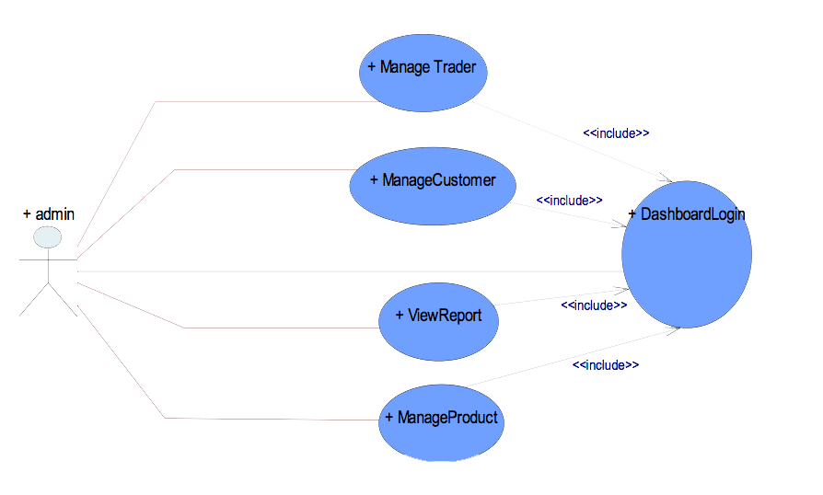
Admin Use Case Diagram
After logging in, admin has the full authority to manage trader/customers
and view report as well as products.

Slide 53
UML Diagram Overview
Login is necessary before
viewing anything into the site
for every customers, traders as
well as admin.
Customers can search products
and manage profile after logged
in.
Traders can add/update/
delete their items as required.
Admin has full authority to view
any customer or trader details.

Slide 54
Wireframing
A critical part of the interaction design process used to design a website service at the structural level.
Commonly used to layout content and functionality on a page which takes into account user needs and user journeys.
Used early in the development process to establish the basic structure of a page before visual design and content is added.
Can also be used to create the global and secondary navigation to ensure the terminology and structure used for the site meets user expectations.

Slide 55
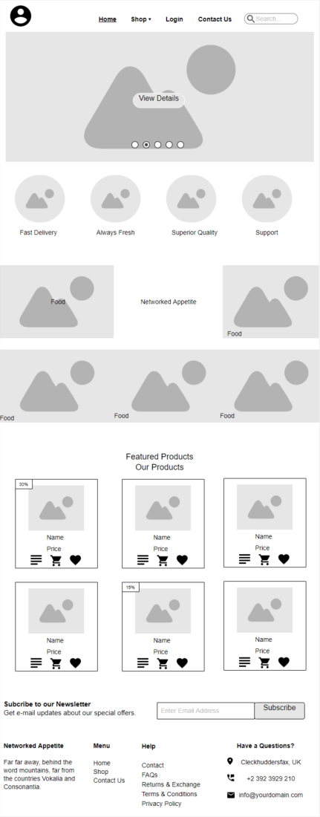
Homepage
The very beginning page of our website.
Contains website logo, navigation link
It outlines different kinds of food available in our store.
Products are tagged in with suitable image, name and price along with add to cart and add to wish list options with them.

Slide 56
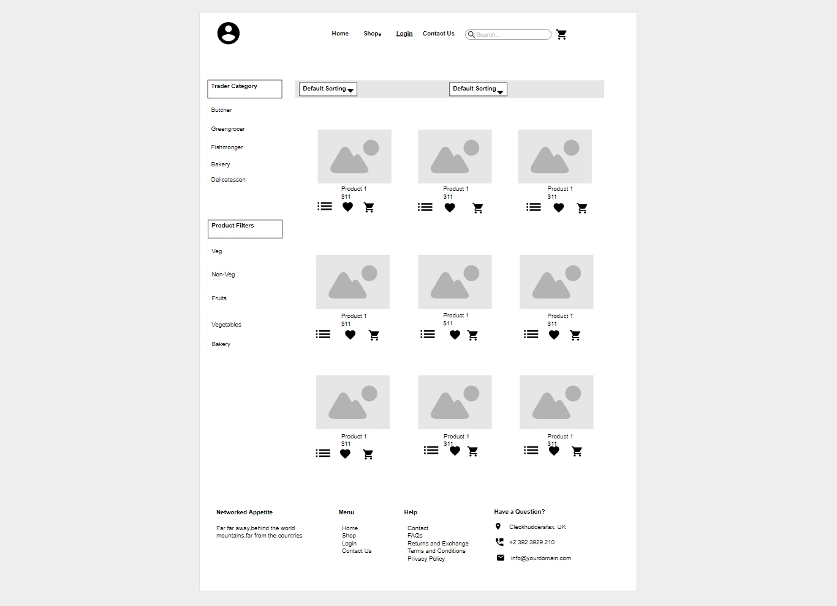
SHOP
Shops are categorized according to their product list.
There are five different category which includes Butcher, Fishmonger, Greengroccer, Bakery and Delicatessen.
Users can browse products normally or they can use filters to find specific product.

Slide 57
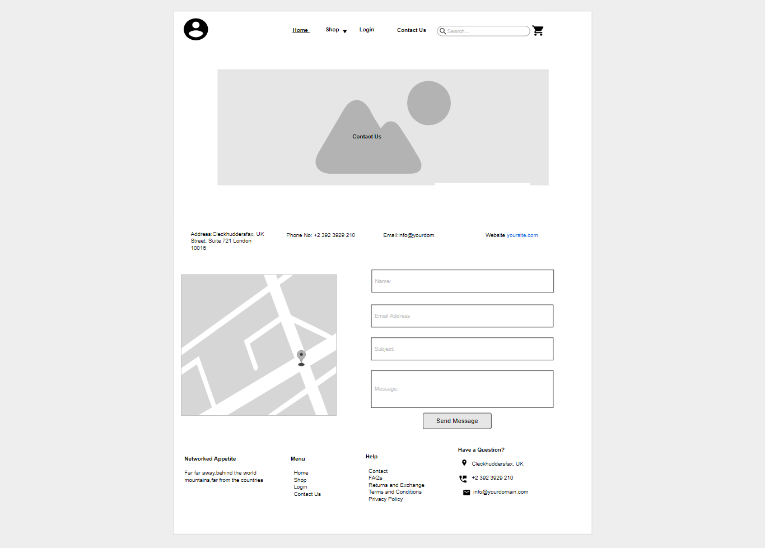
Contact US
Shows the shop detailed information including it’s location.
It includes a form where users can enquiry more about our shop and send messages.

Slide 58
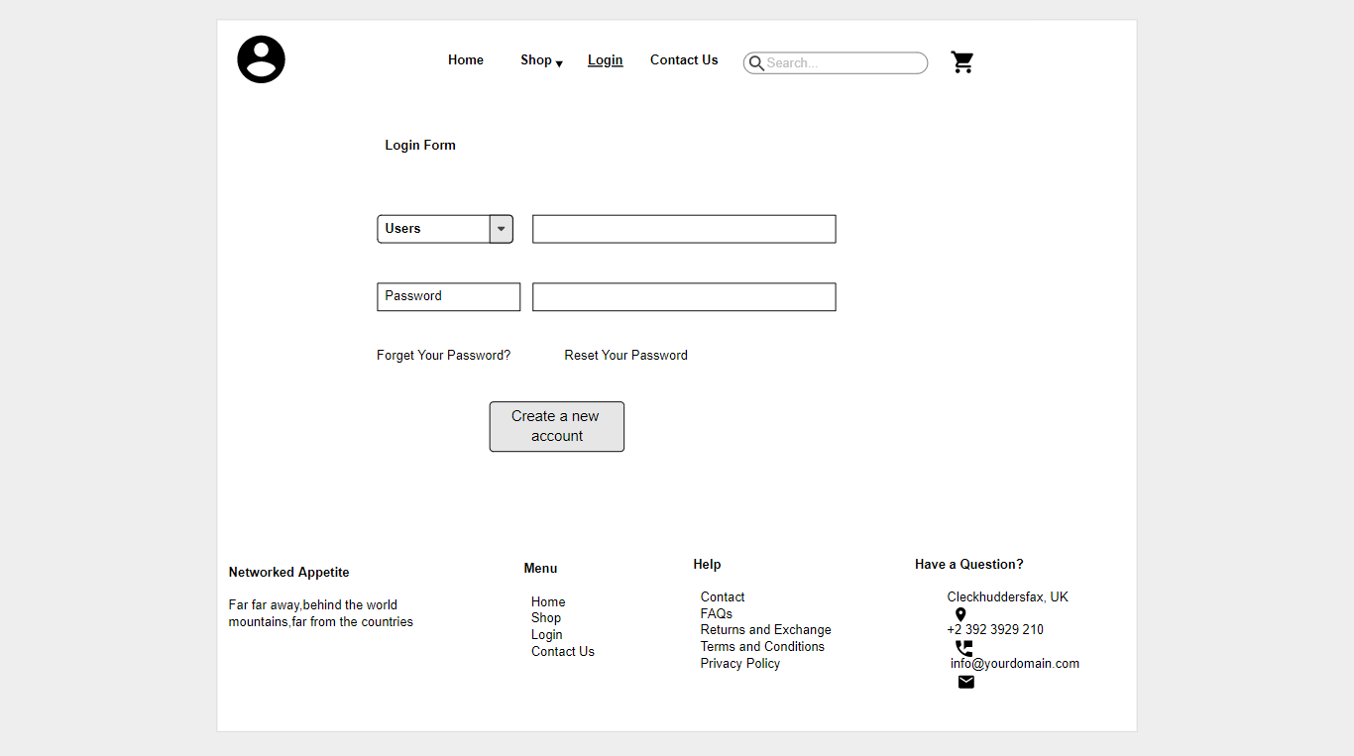
Login
It outlines the login form that allows user to login the website.
Either of the customer or trader can login using this form as identification part is done by the system itself.

Slide 59
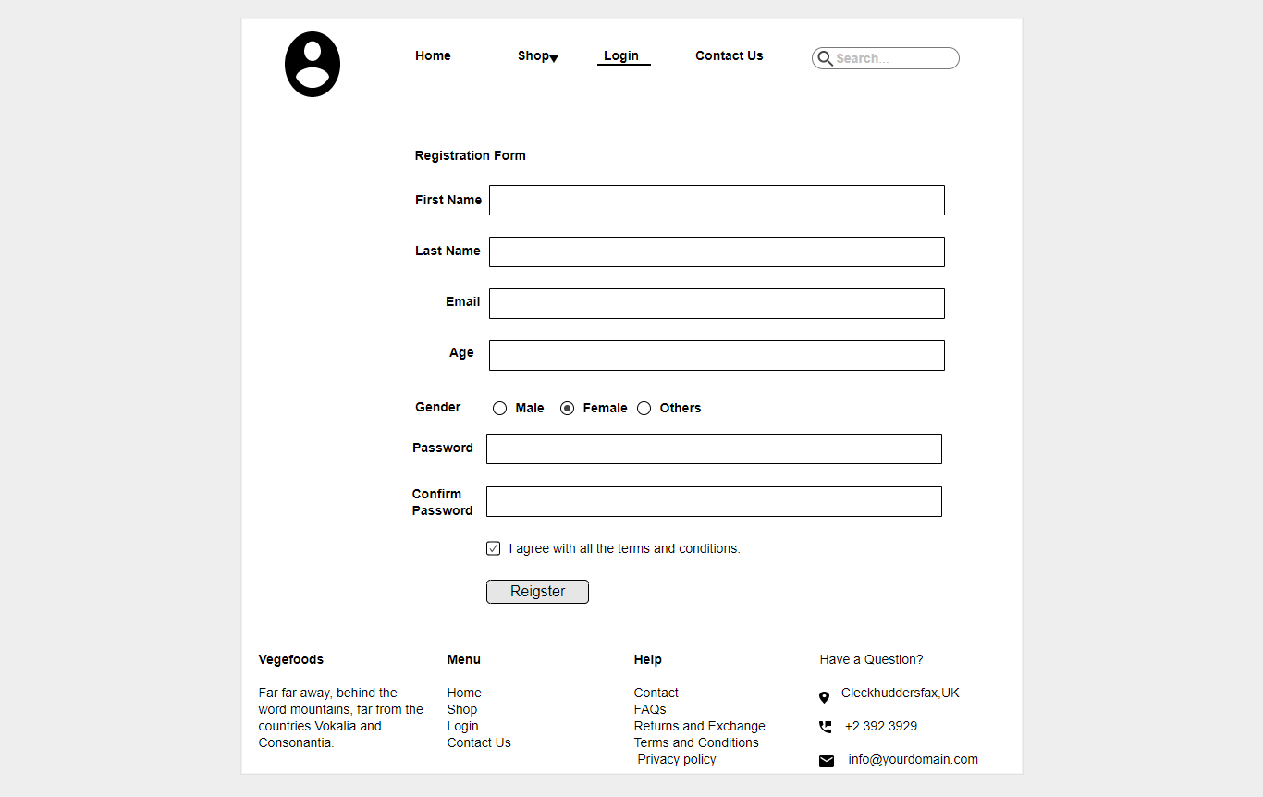
Register(Customer)
Contains a registration form for new customers which includes the detailed information of the customer.
The form won’t be registered until they fill up all the essential credentials and agree with our terms and conditions.
After registering the form they now become the user of our website.

Slide 60
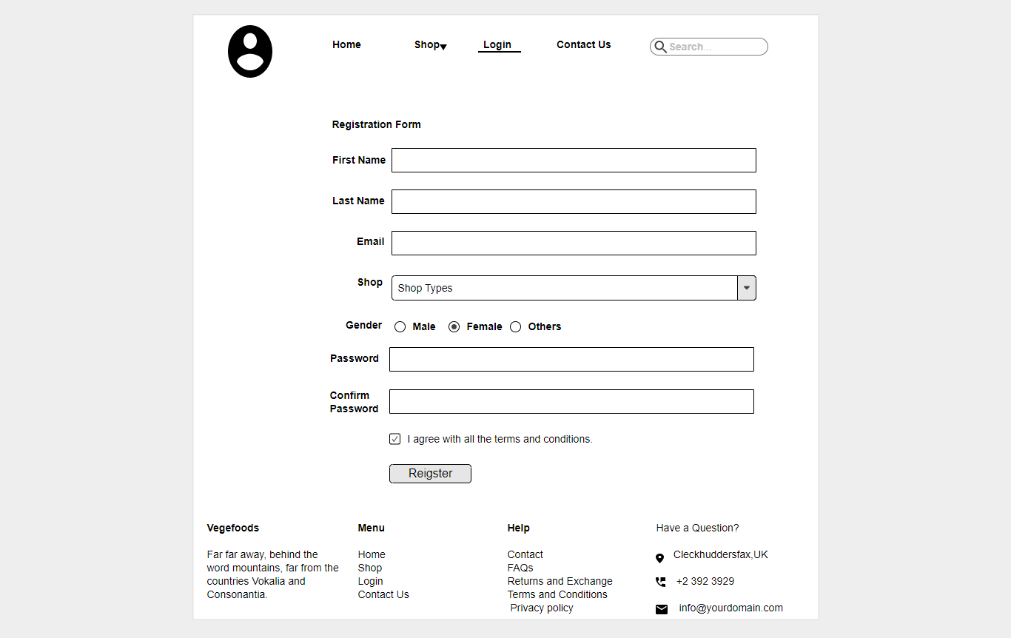
Register(Trader)
This wireframe is somehow same to the customer registration form as it includes all the information about the trader but in this one have to specify the shop type for his/her registration as we have five different categories of shops.

Slide 61
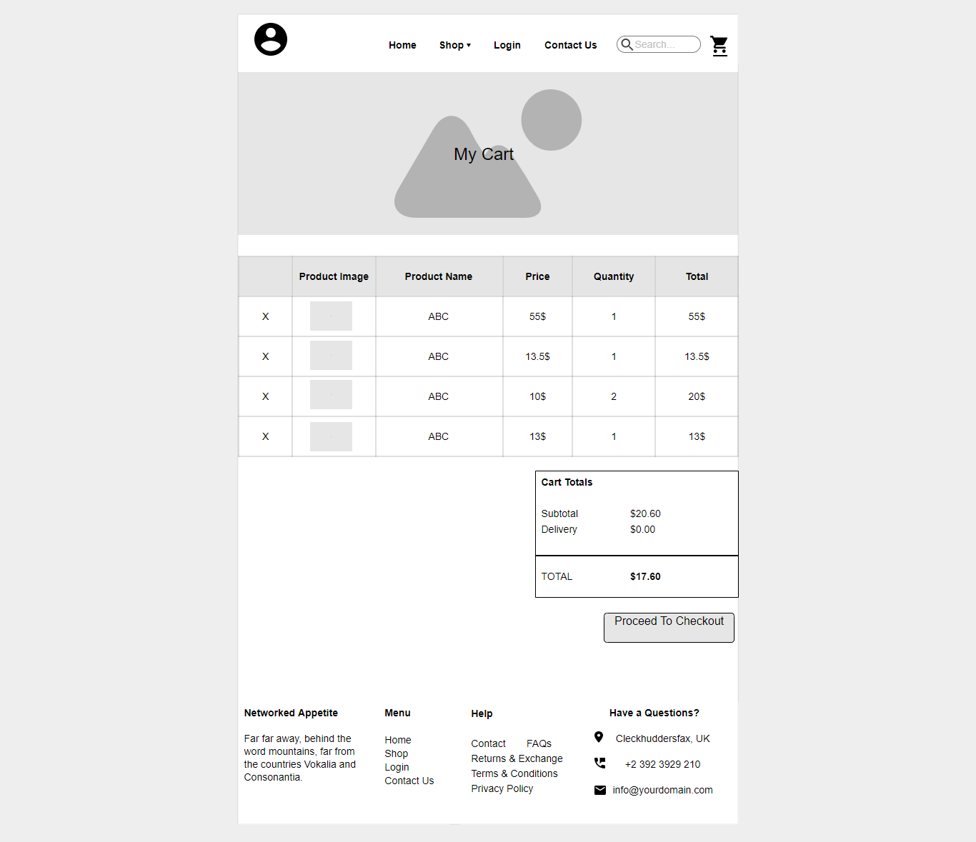
My Cart
This is my cart wireframe which outlines the products which are added by the customer to their particular cart.
In this part it shows the detailed information of the product, it’s name, price, their required quantity of products and finally the total of the selected products.
After adding to the cart, customers have to checkout and make the payment through our specified payment system.

Slide 62
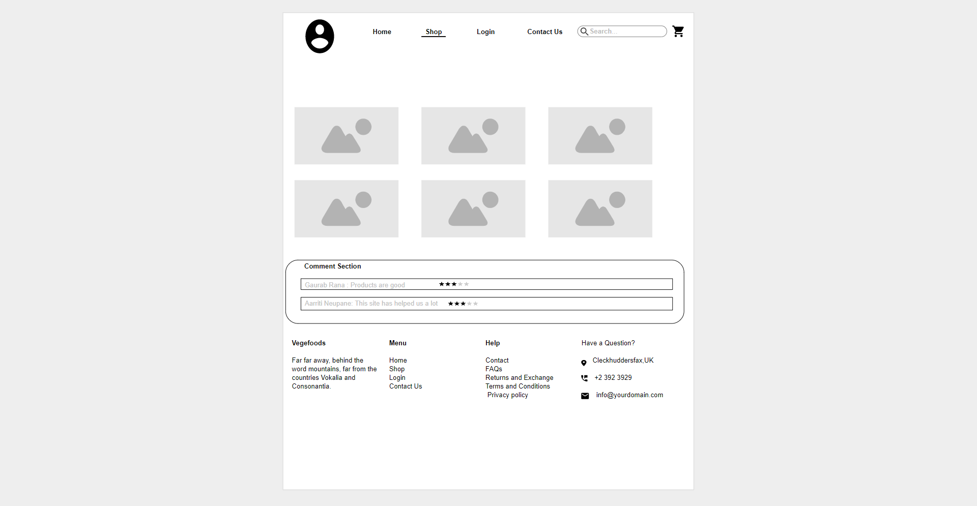
Customer Comment
In this part user can comment about the products, it’s quality, and overall about our system.
Rating system is included where customers are allowed to rate the goods and the system according to their wish.
This helps us to know where our system is been lacking and helps us to improve in those fields.

Slide 63
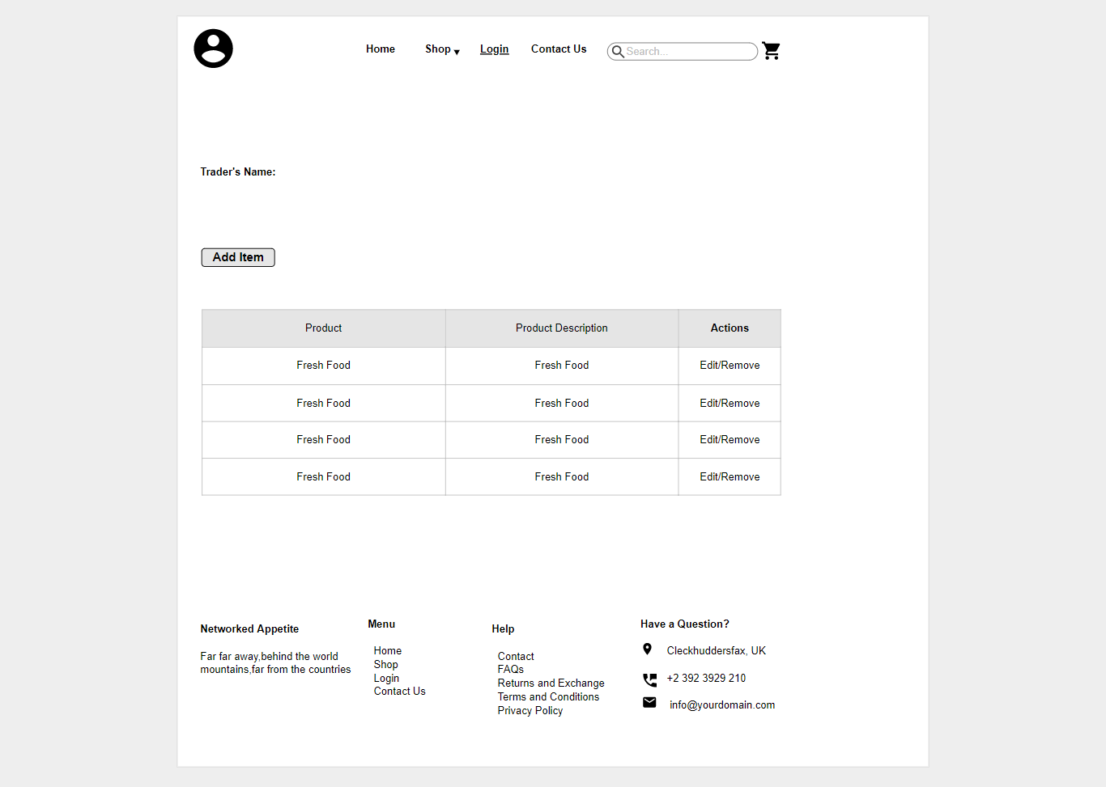
Trader Crud Functions
Each trader opens up their page where they are allowed to add, edit and remove their respective products.
Traders should include short description on each products they include in their list.

Slide 64
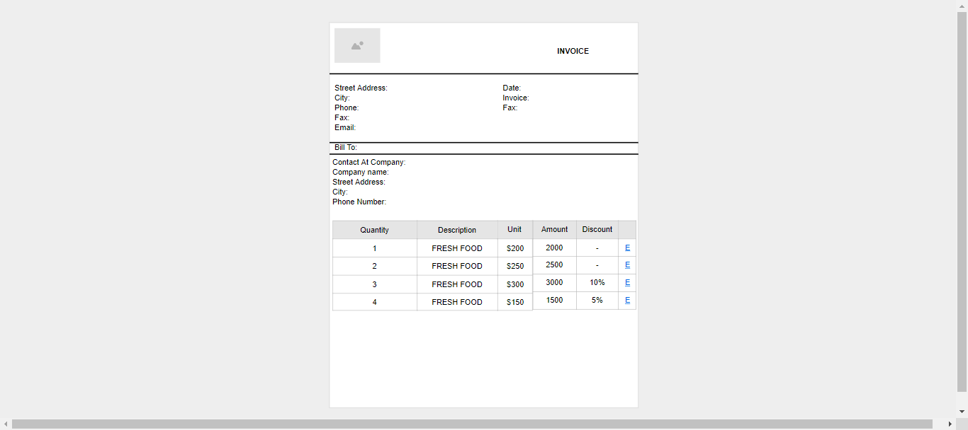
Invoice
After purchasing goods from our store a bill is issued to a particular customers which includes the customer name at the top, discount offered by our store and last the grand total of all the goods .

Slide 65
THANK YOU Any Queries?

